Slide 1

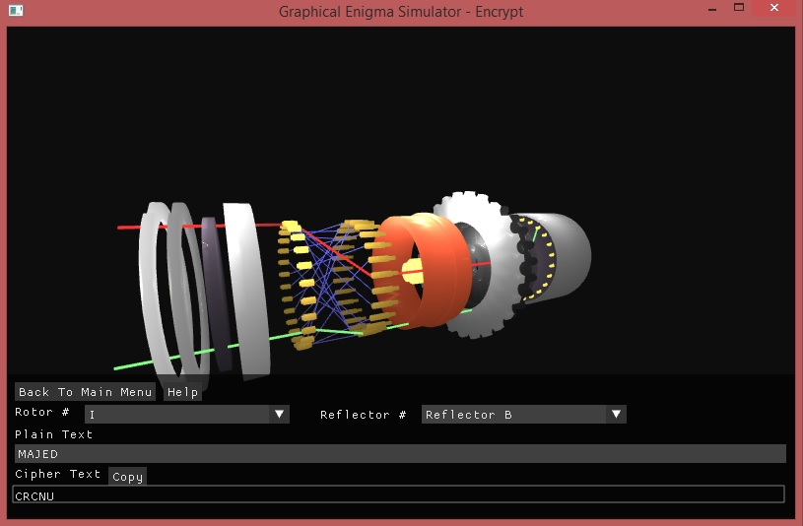
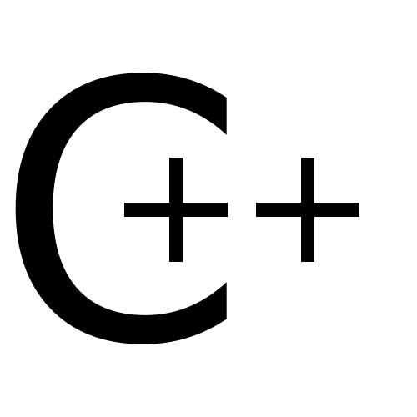


Graphical Enigma Simulator
Majed Monem
Prof. John Arnott
Enigma machines were used in the main during World War II by the German military. It was a device which encrypted plain text into ciphered text. In this project an Enigma simulator was developed.
The simulator demonstrates the process of encryption and decryption via one rotor. OpenGL and C++ was used to create the simulator along with Blender, which was used to create the rotor components.
Challenges:
Learning curve of Blender
Precise alignment of all the components
Integrating a GUI with OpenGL
Achievements:
Basic understanding of Blender
Improved time management
Graphics programming
Understanding of Enigma machines

